Slide 1

GEO3460 – Geografiske informasjonssystemer (GIS) og geografisk datainnsamling – vår 2025
GEO3460 - Geographical Information Systems (GIS) and Geographical Data Acquisition - spring 2025
DEM generation and visualization
Luc Girod (luc.girod@geo.uio.no)
Based on the lectures by Dr. Livia Piermattei

Slide 2

Reference text book:
“Geographical information systems” (not available online)
Chapter 11

Slide 3

Learning Objectives
1
2
3
Elevation data
Definition
DEM data structure
Contour line, TIN, raster
Elevation data source:
Remote sensing
Photogrammetry
Las file
DEM generation
DEM visualization
Hillshade
Example
Today’s topics

Slide 4
Learning Objectives
1
2
3
Elevation data
Definition
DEM data structure
Contour line, TIN, raster
Elevation data source:
Remote sensing
Photogrammetry
Las file
DEM generation
DEM visualization
Hillshaded
Example
Today’s topics

Slide 5
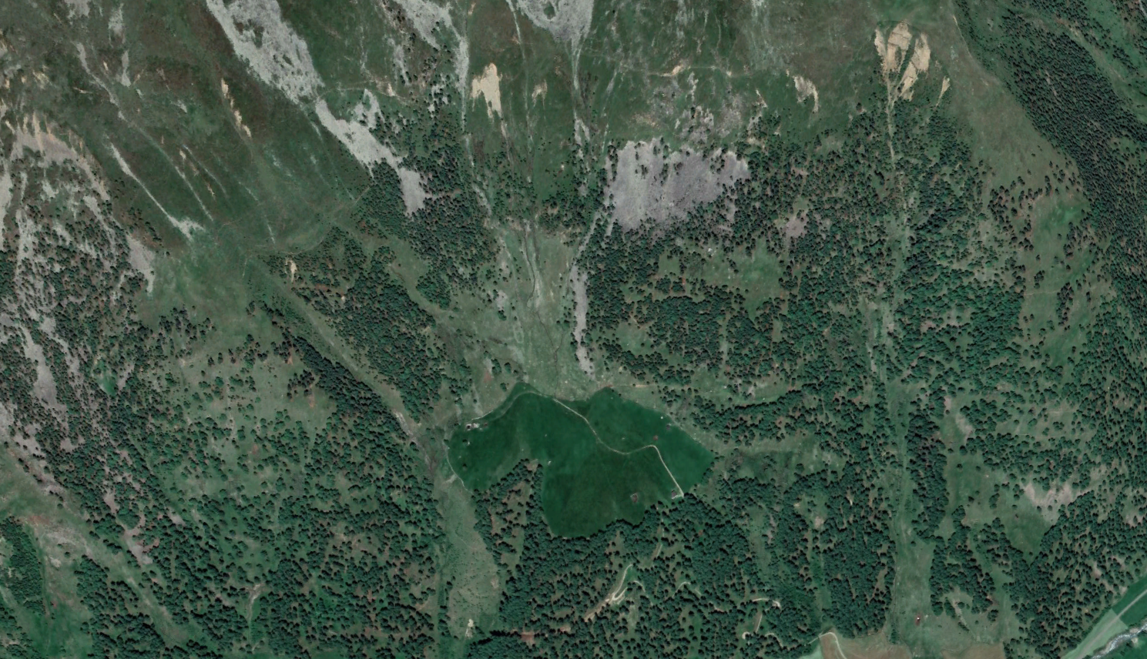
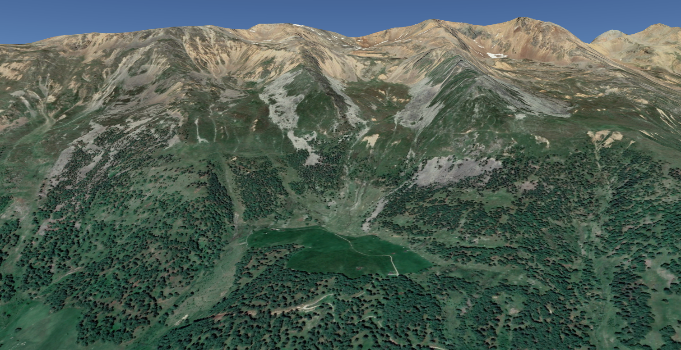
How to represent topography?
LATITUDE, NORTH, Y
ELEVATION, ALTITUDE, Z
point_2
point_1
LONGITUDE, EAST, X
North=Latitude = Y
East =Longitude = X
Elevation = Altitude = Z
point_1 = | point_2 =
423426.532 N | 423743.937 N
42098427.234 E | 42098937.275 E
294.213 Elevation | 296.581 Elevation
Notes:
“Topography is the study of the forms and features of land surfaces.”

Slide 6
How to represent topography?
Digital elevation model (DEM)
Digital terrain model (DTM)
Digital surface model (DSM)
… what does these terms mean?
Notes:
Acronyms

Slide 7
How to represent topography
Digital elevation model (DEM):
A DEM is an elevation model, unmodified from its original data source (such as Lidar, photogrammetry etc.. surface) which could be with or without 'non ground' objects.
Digital terrain model (DTM):
DTM is a synonym of bare-earth DEM
Digital surface model (DSM→DOM på norsk)
DSM is an elevation model that includes the tops of buildings, trees, powerlines, and any other objects. DSM captures the natural and built features on the Earth’s surface.
Notes:
There isn’t 100% consensus on terminology.

Slide 8
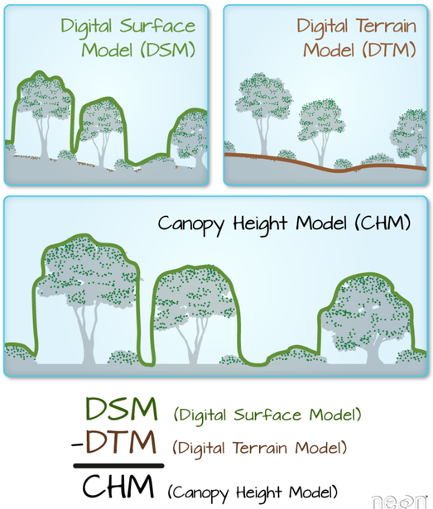
How to represent topography
DEM of Difference: DoD = DEM₁ – DEM₂
Normalized digital surface model: nDSM = DSM – DTM
In forestry application this is called canopy height model (CHM)

Slide 9
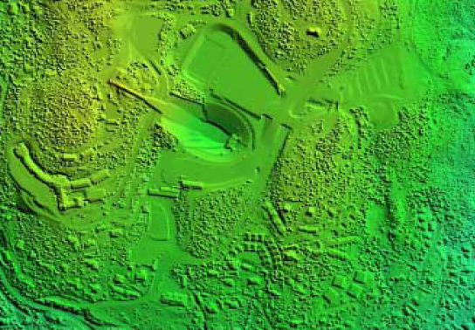
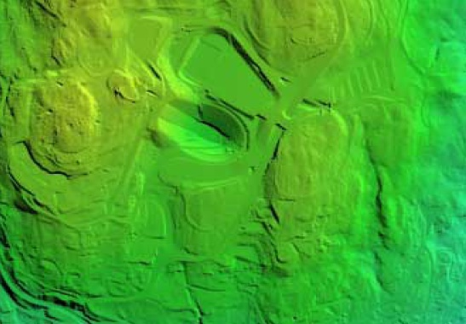
How to represent topography
Digital surface model (DSM)
Digital terrain model (DTM)
Notes:
DISCUSS: What differences can you see?

Slide 10
How to represent topography
DEM generation (data structure)
Lines (vector) – contour map
Raster –matrix with elevation information
Triangles (vector) – TIN/Triangulated irregular network

Slide 11
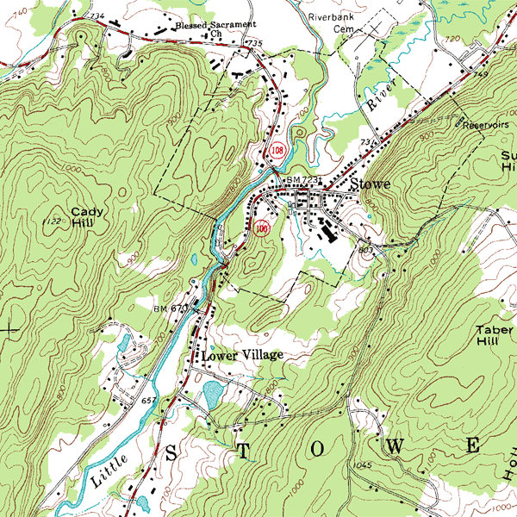
DEM generation
Lines: contour lines (or contour) and contour map
What are all these lines curving all over the place?
A topographic map of Stowe, Vermont with contour lines
Notes:
What are all the squiggley lines curving all over the place?

Slide 12
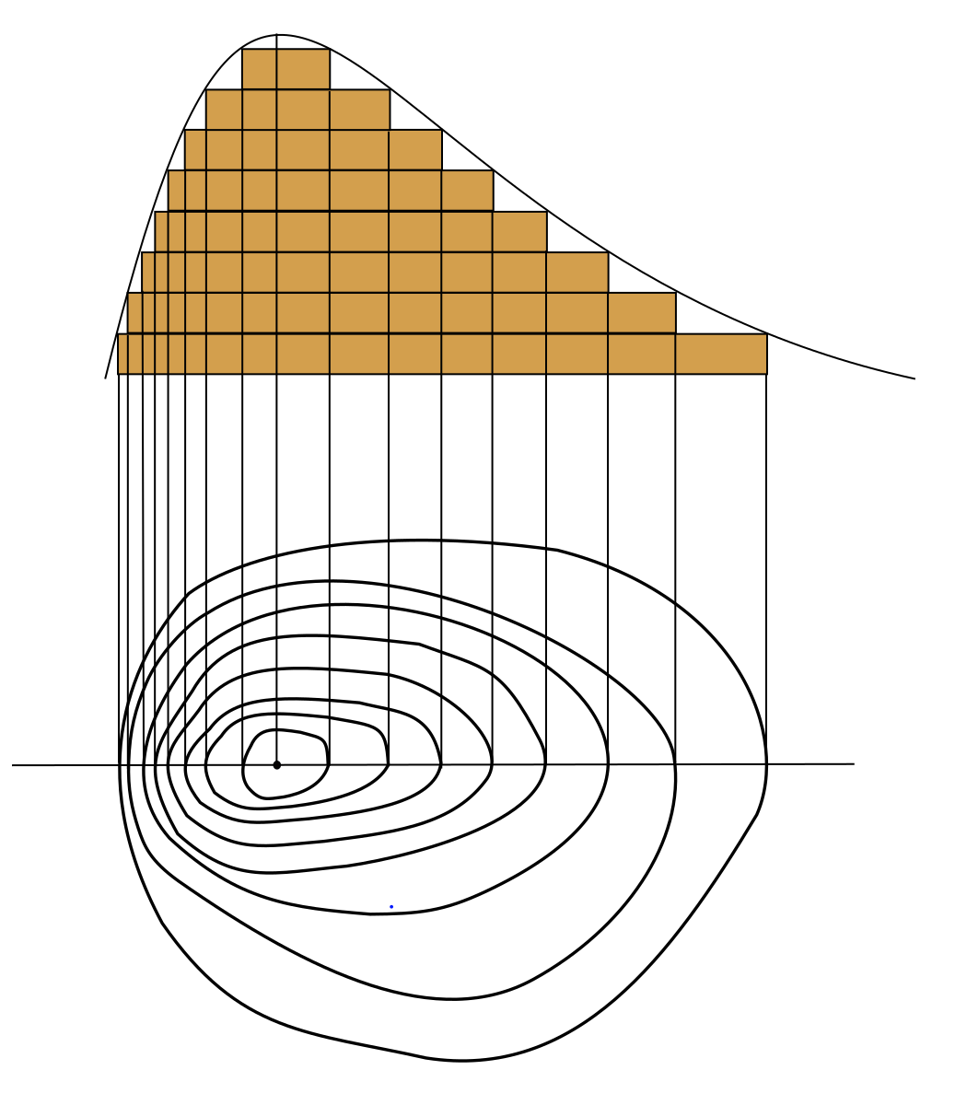
DEM generation
Lines: contour lines (or contour) and contour map
Contour lines are vector features
Contour line: a line that joins points of equal elevation (height) above a given level, e.g. mean sea level.
→ all the points in the line have equal value
A contour map is a map illustrated with contour lines (e.g. topographic map)
Limited visualization and analysis possibility
Notes:
The bottom part of the diagram shows some contour lines with a straight line running through the location of the maximum value.
The curve at the top represents the values along that straight line.

Slide 13
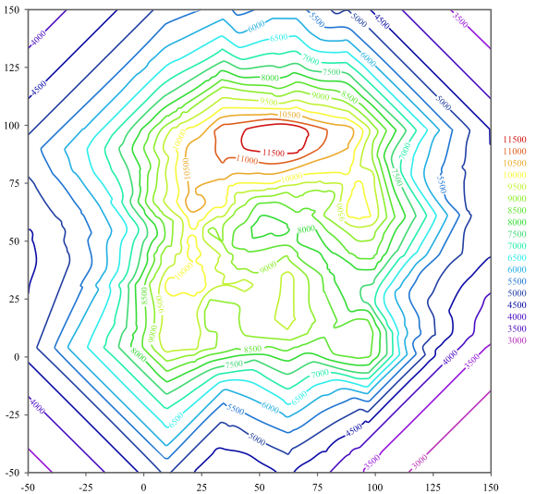
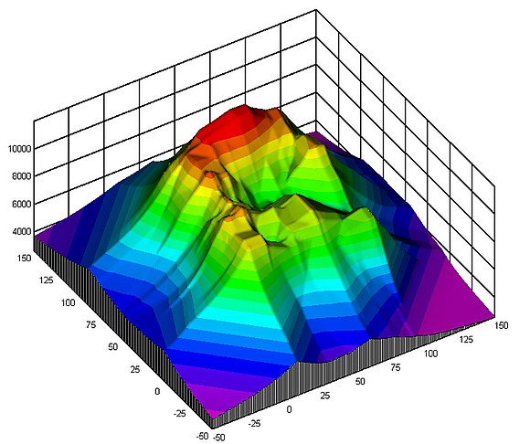
DEM generation
Lines: contour lines (or contour) and contour map
A 2D contour graph of the 3D surface
A three-dimensional (3D) surface
Notes:
Hilltop and mountain peak

Slide 14
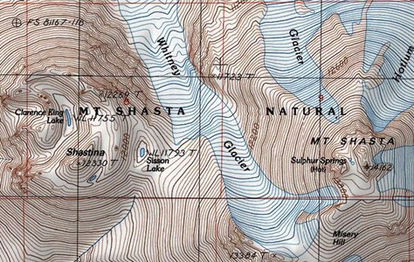
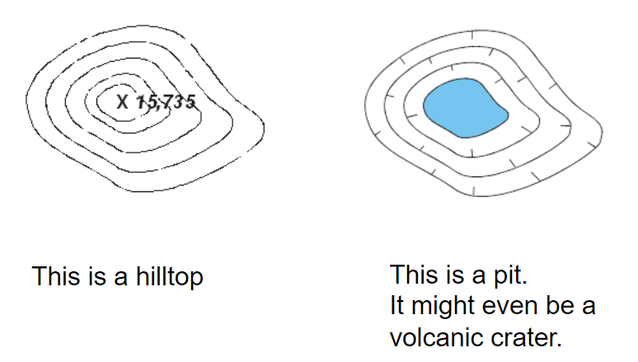
DEM generation
Lines: contour lines (or contour) and contour map
How interpret contour map
What is this?
What is this?
Notes:
Hilltop and mountain peak. Can you see the hash marks pointing inward? Those marks point downhill, often toward a lake or a pond

Slide 15
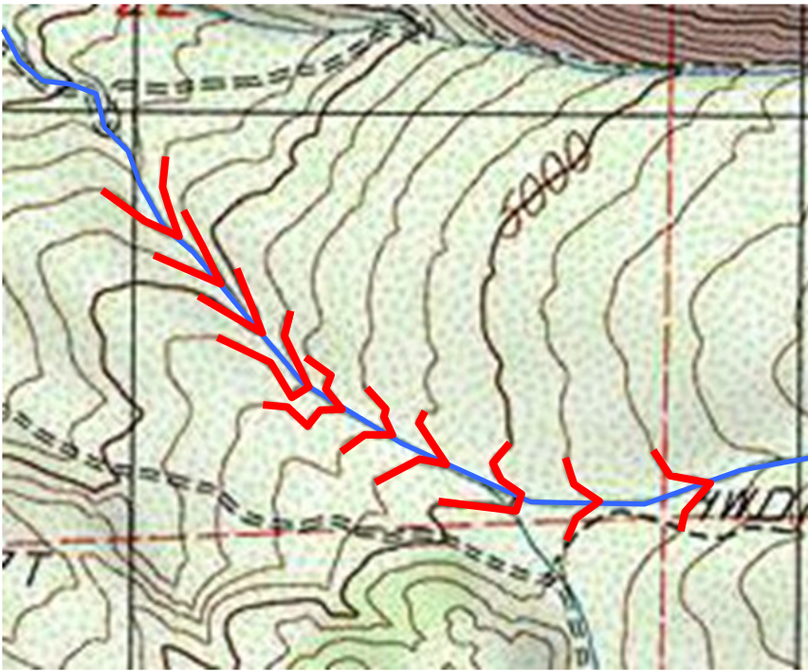
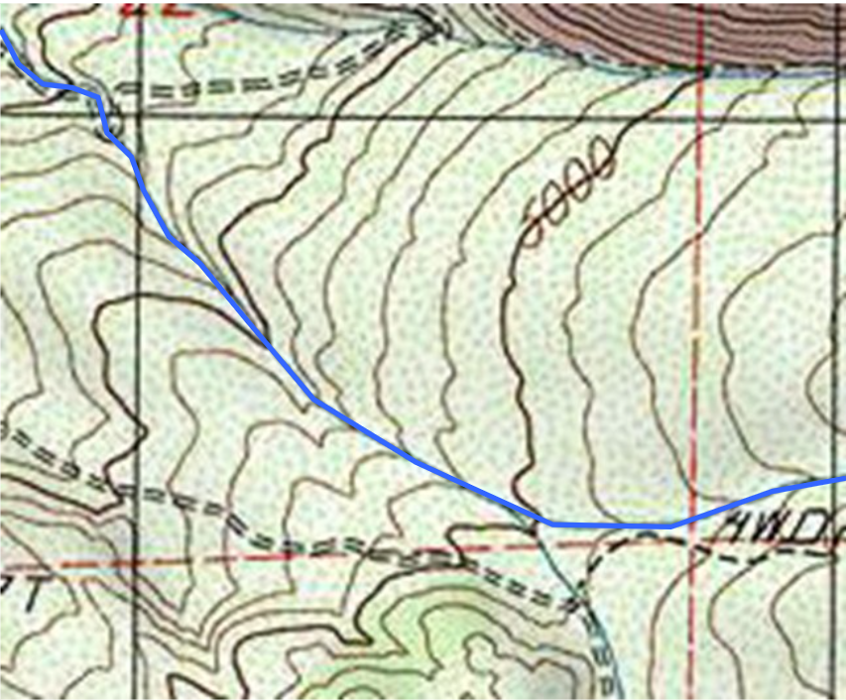
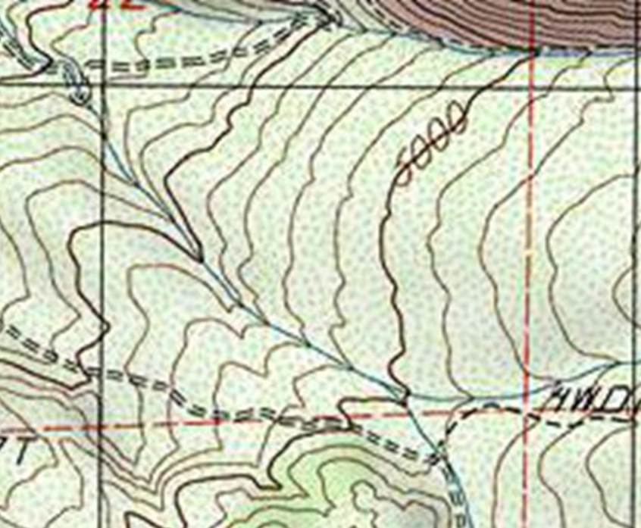
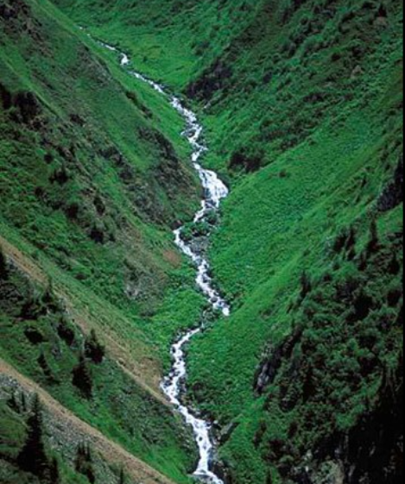
DEM generation
Lines: contour lines (or contour) and contour map
How interpret contour map
The blue line is the river and the “v” lines indicate steep slope
Photo of a river between step slope
Notes:
The numbers found on some of the lines indicate...... elevation = altitude = height above sea level Note that the scale is in metric units (5000 m doesn´t sound very plausible though, especially since the other maps clearly are in feet…), so the elevations are in meters.

Slide 16
DEM generation
Lines: contour lines (or contour) and contour map
How interpret contour map
The numbers on some of the lines indicate elevation / altitude / height above sea level
What is this?
Notes:
The numbers found on some of the lines indicate...... elevation = altitude = height above sea level
Note that the scale is in metric units, so the elevations are in meters. (5000 m doesn´t sound very plausible though, especially since the other maps clearly are in feet…)

Slide 17
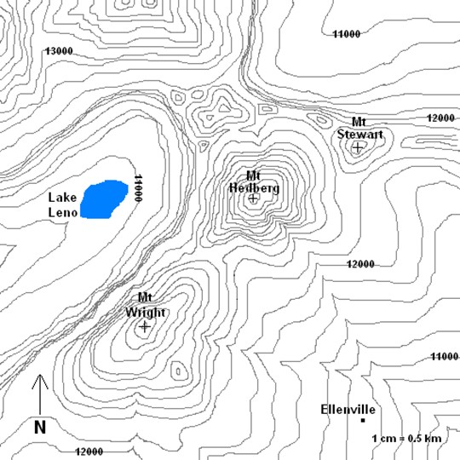
DEM generation
Lines: contour lines (or contour) and contour map
How interpret contour map
What does it mean when the lines are all close together?
What does it mean when the lines are spread far apart?
Where on the map do you think streams would flow during the rainy season or in the spring when snow melts?
What direction would you think the streams flow?
Where are the flat areas?
Where are the cliffs?
Notes:
DISCUSS: The questions on the slide (5 min or so)
What does it mean when the lines are all close together?... A steep slope, maybe even a cliff.
What does it mean when the lines are spread far apart?... A gentle slope, maybe even terrain you would call “flat”
Where on the map do you think streams would flow during the rainy season or in the spring when snow melts?... Look for the parallel “V’s” that point uphill.
What direction would you think the streams flow? … From the point of the “V” towards the opening, i.e. from higher to lower elevation
Where are the flat areas?... wherever the lines are far apart
Where are the cliffs?... wherever the lines are close together

Slide 18
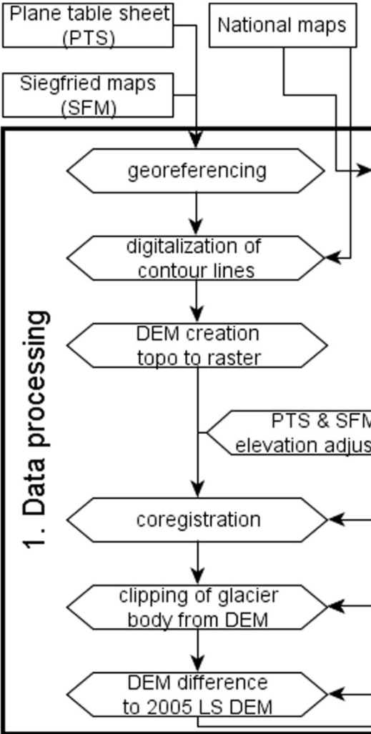
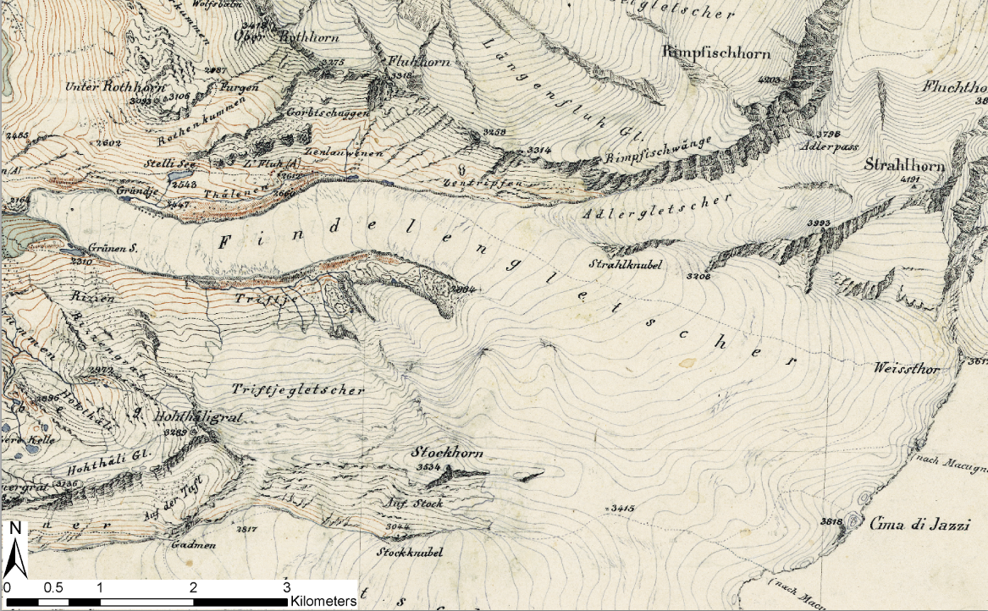
DEM generation: map digitization
Application: Long-term DEM generation based on historical topographic maps
Dufourkarte MTB 1859
“Historical analysis and visualization of the retreat of Findelengletscher, Switzerland, 1859–2010.”
Rastner et al., 2016
Notes:
Characterization of the state and shape of the terrain features and their changes

Slide 19
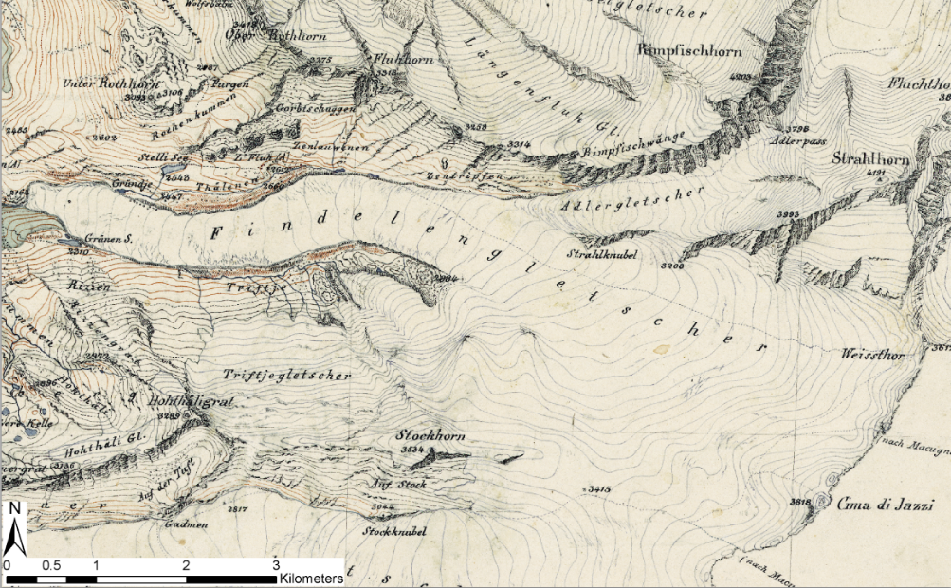
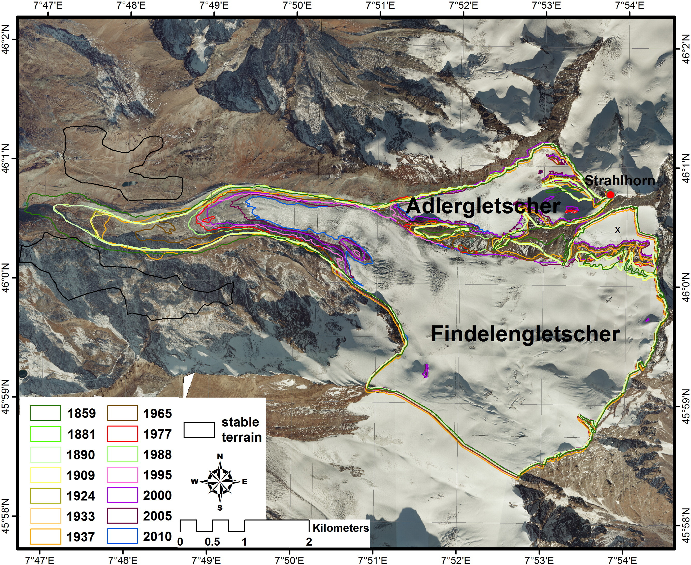
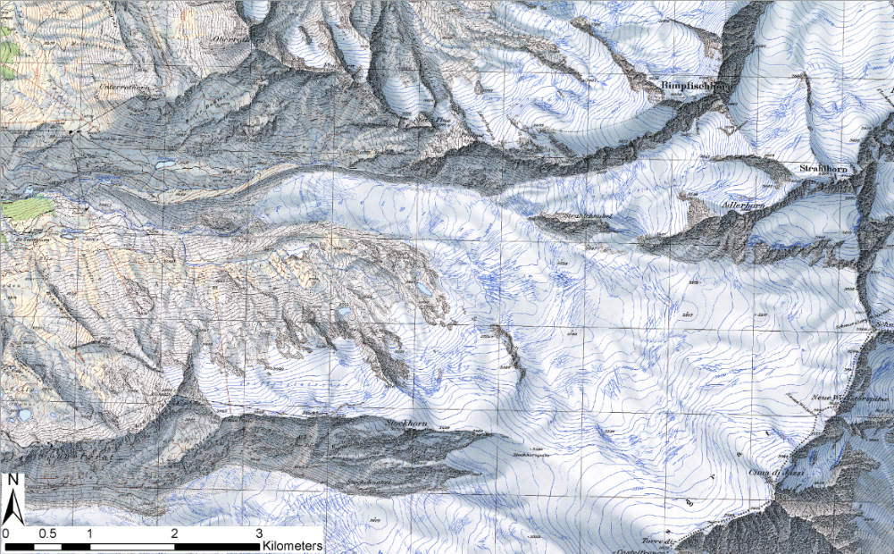
DEM generation: map digitization
Dufourkarte MTB 1862
Application: Long-term DEM generation based on historical topographic maps
Swisstopo Karte 1977
Notes:
Characterization of the state and shape of the terrain features and their changes

Slide 20
DEM generation
Elevation raster – matrix with elevation information
Most common representation of the elevation
Easy analyses and modelling
Rigid data structure (i.e. resolution)
Limited adaption to topographic structures
The topographic surface height z is a function of planimetric coordinates
z = f(x, y)
Notes:
Characterization of the state and shape of the terrain features and their changes
Planimetrics is the study of plane measurements, including angles, distances, and areas.
In geography
Planimetric elements in geography are those features that are independent of elevation, such as roads, building footprints, and rivers and lakes. They are represented on two-dimensional maps as they are seen from the air, or in aerial photography.[1] These features are often digitized from orthorectified aerial photography into data layers that can be used in analysis and cartographic outputs.[2]
A planimetric map is one that does not include relief data.[3]

Slide 21
Comparison between lines, raster and TIN
DTM describes continuous topography (ground level)
Different data model:
Raster (grid model) vs Vector (elevation curves or TIN)
Resolution?
Grid (cell) size = fixed distance between point heights
Elevation curves: equidistance, vertical resolution
TIN: variable resolution ≈ average point distance
Accuracy?
Depends on measurement method (quality), density (quantity), roughness and topography (e.g. slope)
High resolution does not necessarily mean good DTM, but a good DTM needs high resolution (and accurate data!) To describe small feature

Slide 22
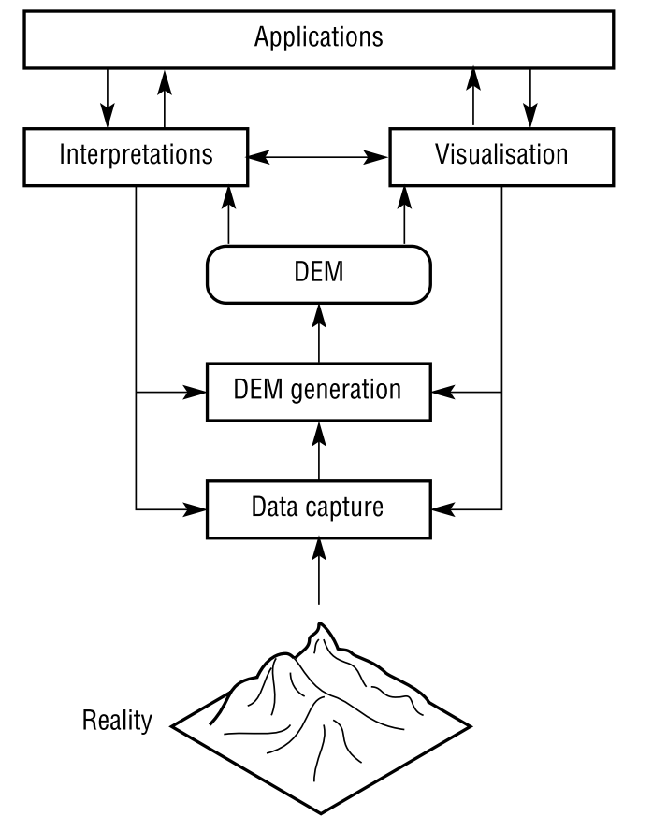
DEM
The main tasks associated with DEM
The applications should guide data capture
The resolution of data source should guide the choice of resolution of generated DEMs
The resolution of DEM should be matched to the natural scales of terrain-dependent applications
Analysis of the errors associated with these data sources is an essential part of DEM generation.

Slide 23
DEM
Some questions to answer when choosing the data and interpolation method:
What is the area I have to reconstruct?
What is the topography of my area (e.g. elevation, roughness, slope, vegetation, land cover, etc.)?
What do I need to analyze (volume, river dynamics, glacier mass balance, soil erosion, etc…)
What's the resolution (point density) of the point cloud that you get from the data?
Do you need cm/mm/m accuracy in the vertical or the horizontal?
Other questions that you have in mind?
Notes:
What's the resolution (point separation) of the point cloud that you get from the photogrammetry? Do you need cm/mm accuracy in the vertical or the horizontal? I assume you are referring to the horizontal accuracy in which case why do you need that fine of resolution over that large of an excavation area? For most cases elevation does not change rapidly enough over space to require that fine of resolution. If you're comfortable with the granularity of the point cloud then using 3D analyst you can produce a TIN. I prefer using TIN in my volume calculations because I can develop a excavation surface using polygons and use the Polygon Volume tool to do the volume calculations. If the point cloud is coarse and you can hold to the assumptions of normality and stationarity, I usually lean toward probabilistic methods like Kriging so I can get a handle on the error in the interpolation. Else IDW works fine for high resolution (1m or less) point data.
Do I need an orthophoto?

Slide 24
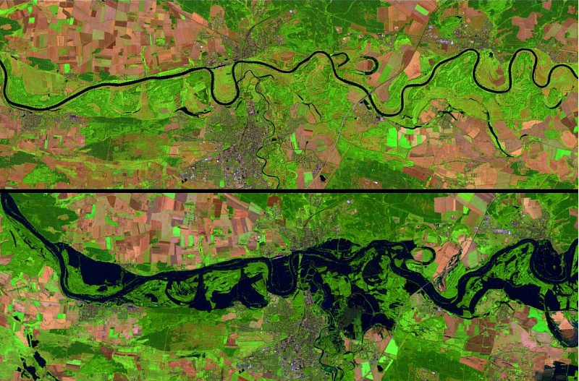
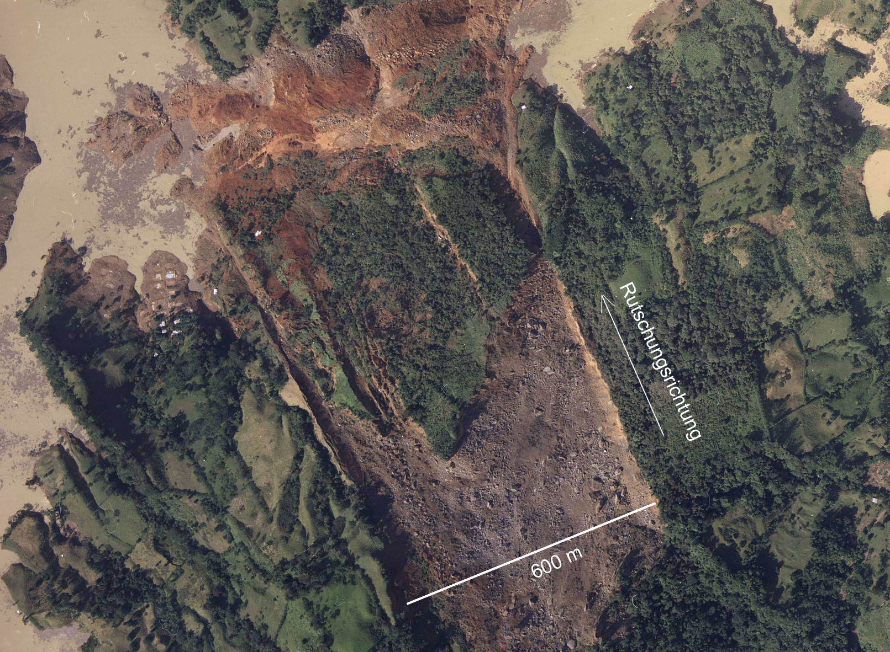
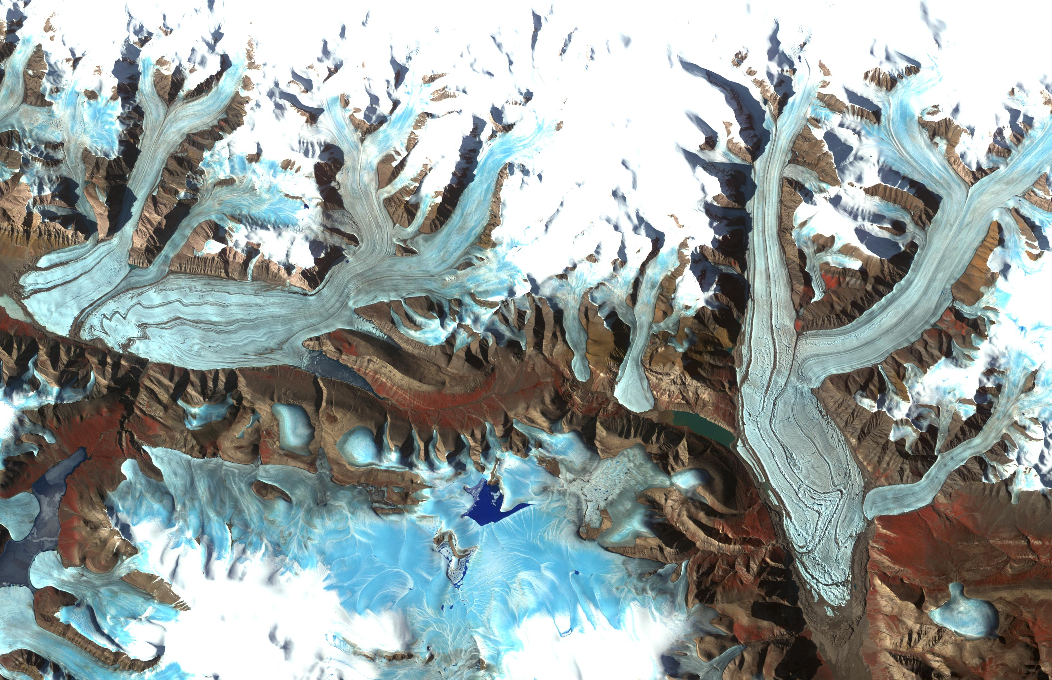
DEM applications
Elevation data are some of the most important and widely-used data in the GIS world
Applications in…
Geomorphology
Glaciology
Geology
Forestry
Hydrology
Landscape ecology
Natural hazards
Archaeology
And many, many others…
Floodplain (before and after)

Slide 25
Learning Objectives
1
2
3
Elevation data
Definition
DEM data structure
Contour line, TIN, raster
Elevation data source:
Remote sensing
Photogrammetry
Las file
DEM generation
DEM visualization
Hillshaded
Example
Today’s topics

Slide 26
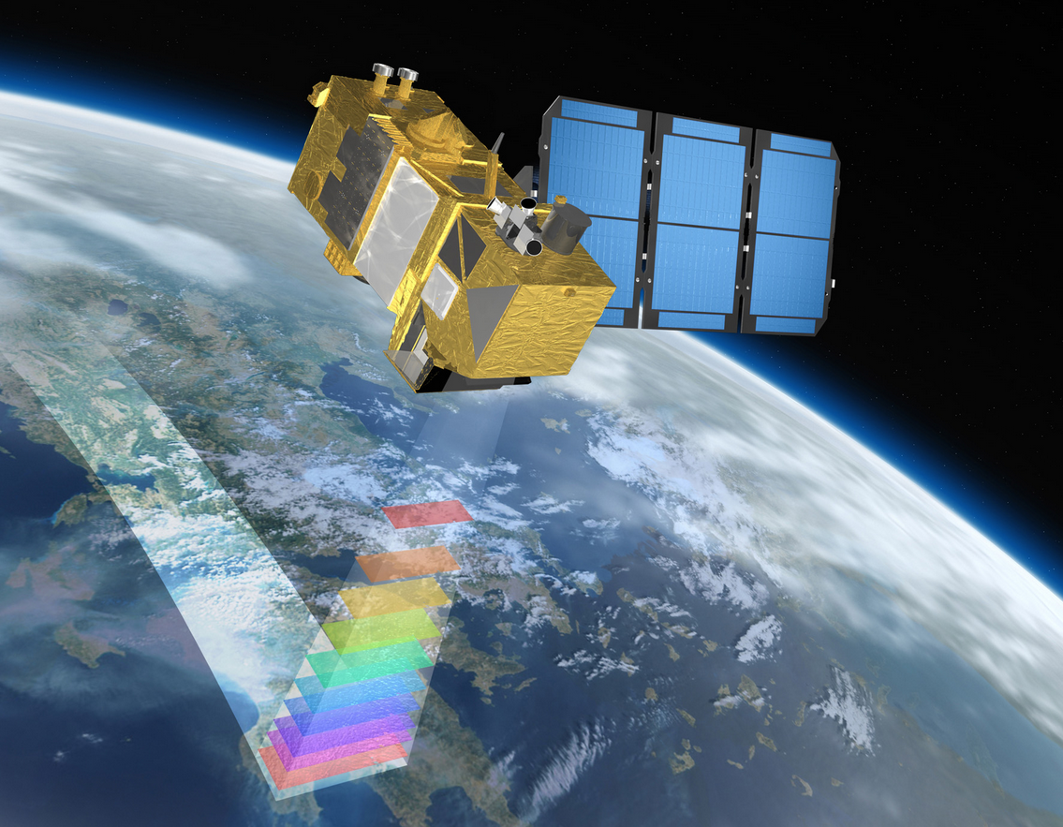
Elevation (DEM) data capture

Slide 27
Elevation data sources
Spaceborne remote sensing
Stereoscopic satellite imagery
Radar-based satellite imagery (e.g. Synthetic aperture radar, SAR)
Airborne remote sensing:
Lidar (e.g. Airborne laser scanning, ALS)
Photogrammetry (e.g. aerial images, UAV photogrammetry, existing cartographic maps)
Ground-based remote sensing and data survey:
Real Time Kinematic Global Positioning System (RTK-GPS)
Total Station
Terrestrial laser scanning (TLS)
Terrestrial photogrammetry

Slide 28
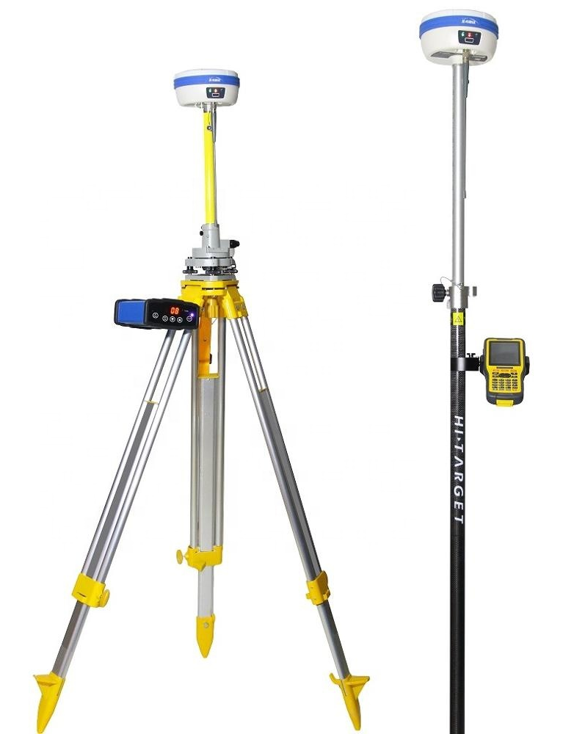
Elevation data sources
GPS Points
Irregularly spaced
May or may not represent surface-specific peaks and pits
Used for control,
quality assessment
benchmarking other data
Ground control points for photogrammetric and Lidar data collection
Potentially significant attribution per point
Typically small quantities

Slide 29
Elevation data sources: Remote sensing
Passive
Camera
Active
SAR
Laser scanner (Lidar)
Sensors - categories
Optical
In general short wavelength
Thermal
Microwave
Wavelength from 1cm-1m
Spaceborne
Airborne
Close-range/ ground-based
Polar orbiting
Geostationary
Over the equator
Notes:
QUESTION: What’s the difference between a passive and an active sensor?

Slide 30
Elevation data sources: Remote sensing
Remote sensing methods can be compared considering
Sensor parameters
Type of sensor: passive, active
Which part of the electromagnetic spectrum is covered?
Costs
Accuracy
Temporal resolution: data availability (start and end of the measurements)
Spatial resolution (sampling density)
Pre-processing requirements
(Accessibility to the area and flexibility)

Slide 31
Elevation data sources: LiDAR
Direct measurements of the elevation
LiDAR (LIght Detection And Ranging) is an optical remote-sensing technique that uses laser light to densely sample the surface of the Earth producing highly accurate x,y,z measurements (point cloud).
General characteristics of Lidar:
LiDAR point clouds stored in LAS format
High point spacing density (approximately 1-100 points per square meter, Airborne and TLS)
Often, but not always, filtered to bare earth points
Every point contains attributes stored with the x,y,z data (e.g. intensity, time, echo)
Large quantities of point data
Notes:
High point spacing density (approximately 1 to 20 point/sqr meters) depending on application, sensor, platform, distance, costs…
The LAS (LASer) format is a file format designed for the interchange and archiving of lidar point cloud data. It is an open, binary format specified by the American Society for Photogrammetry and Remote Sensing (ASPRS). The format is widely used[1] and regarded as an industry standard for lidar data.[2][3]
Intensity of the LiDAR point clouds can be used for numerous applications, including:
Feature detection and point cloud classification
Feature registration with Geo-Photomap imagery data
Distinguishing features
Land cover classification
Identifying wet areas in forested areas (due to the tendency of the sensor signal to be absorbed by water)
Vegetation classification

Slide 32
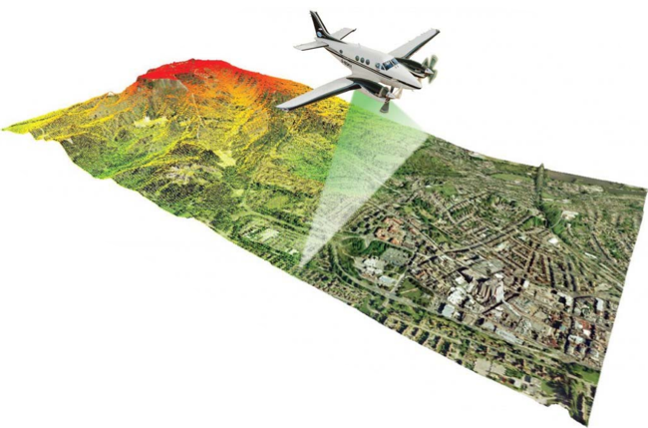
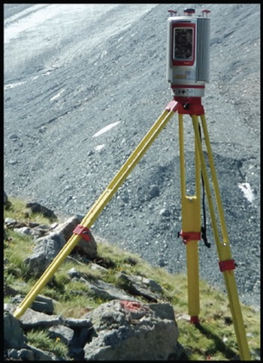
Elevation data sources: Lidar
Direct measurements of the elevation (ground, plane or satellite)
Airborne laser scanning (ALS)
Terrestrial laser scanning (TLS)
Data format:
3D Point cloud (x,y,z, attributes)
Elevation
Intensity information
File format: .las, .laz

Slide 33
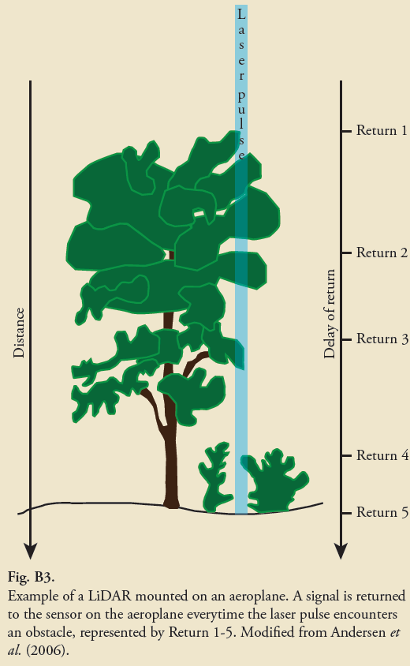
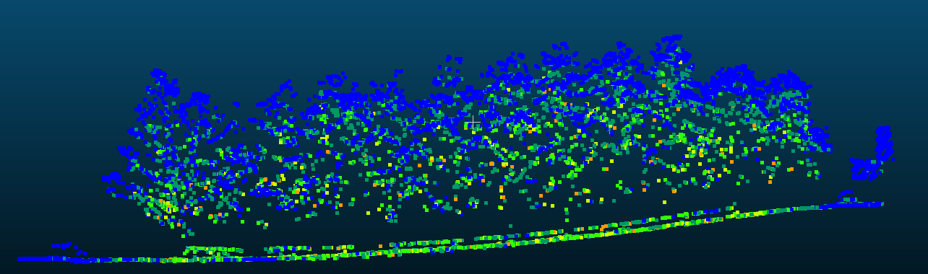
Elevation data sources: Lidar
Bernhardson 2018

Slide 34
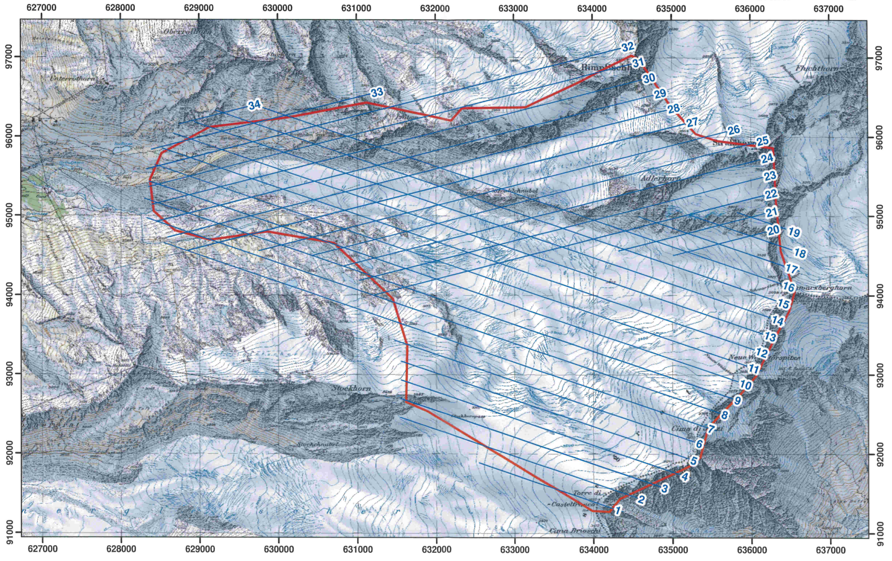
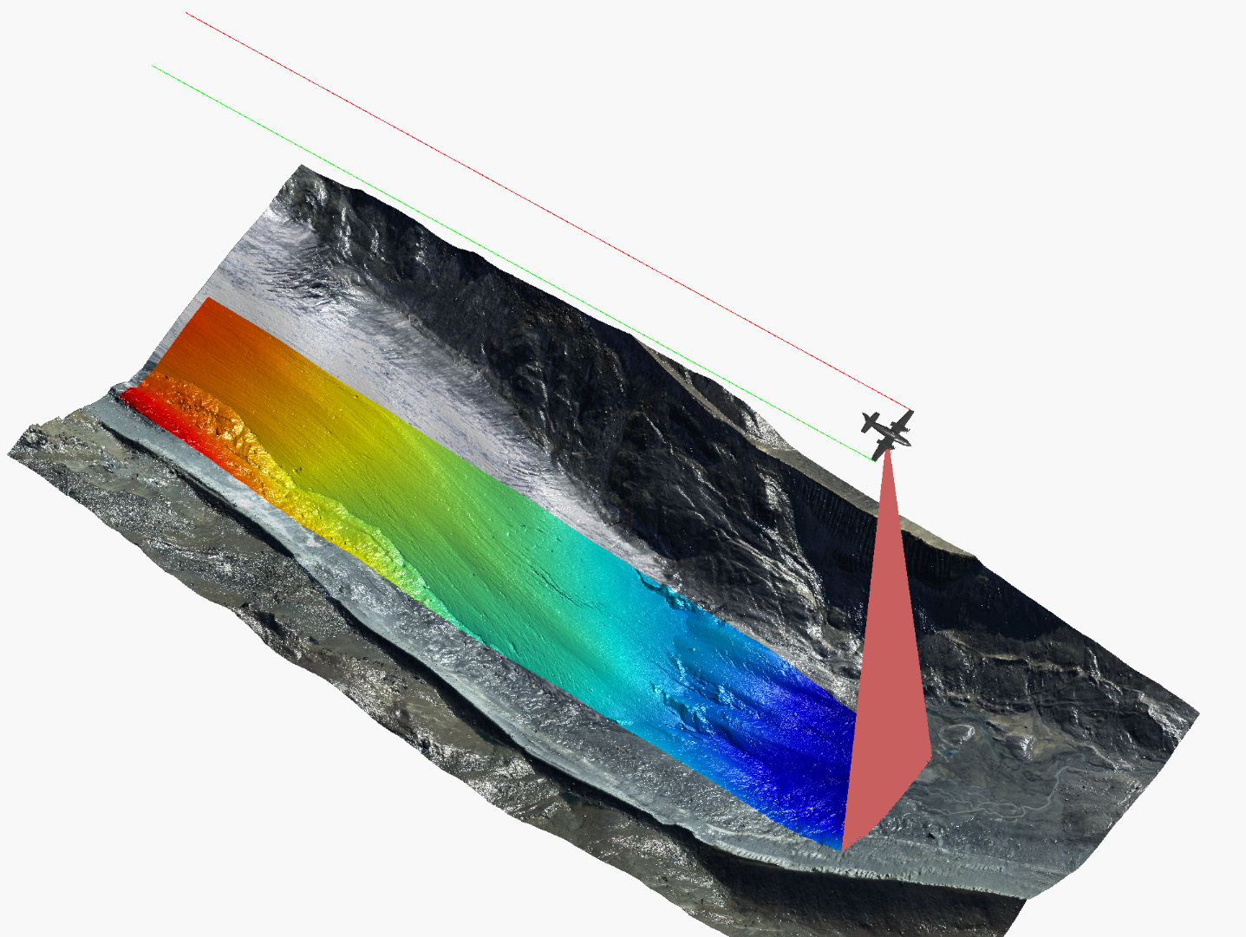
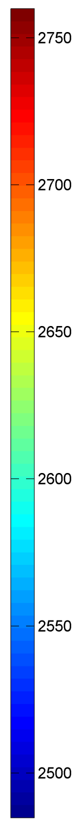
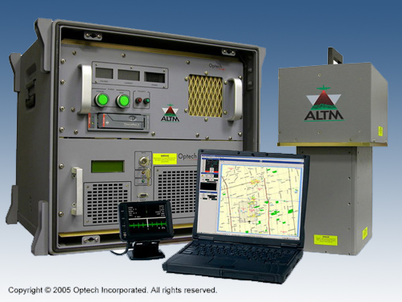
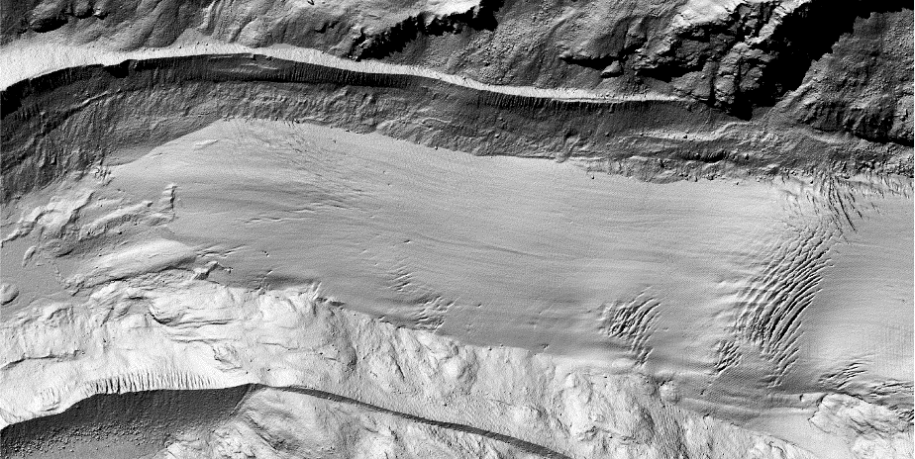
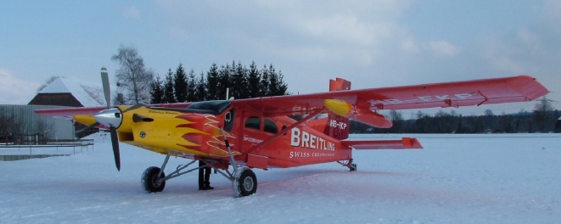
Elevation data sources: Lidar
Direct measurements of the elevation (ground, plane or satellite)
Airborne laser scanning (ALS)
Courtesy of BSF Swissphoto
Point density of 1-14 point per m², which were interpolated to a DEM (raster representation) with the very high resolution of 1m
Joerg et al. 2012. Uncertainty assessment of multi-temporal airborne laser scanning data: A case study on an Alpine glacier
Notes:
This is a very luxury version .applying such techniques is very cost-intensive.
Besides measurements from aerial platforms (plane), space borne measurements can also be useful to receive data especially for remote regions

Slide 35
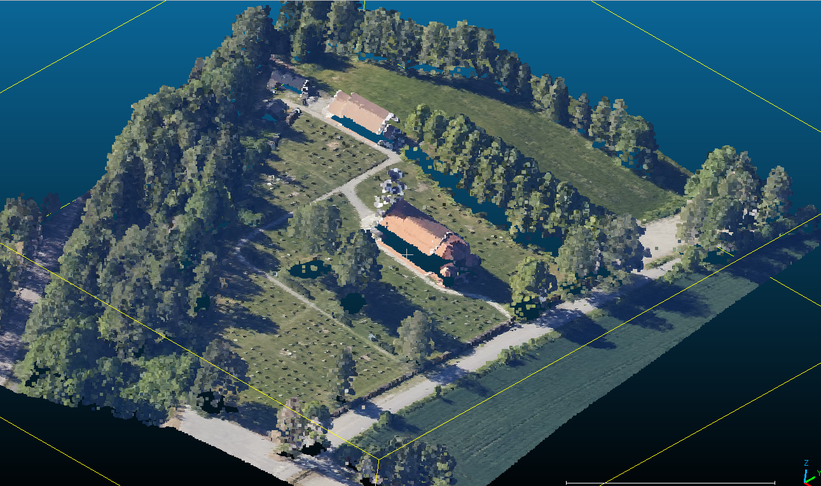
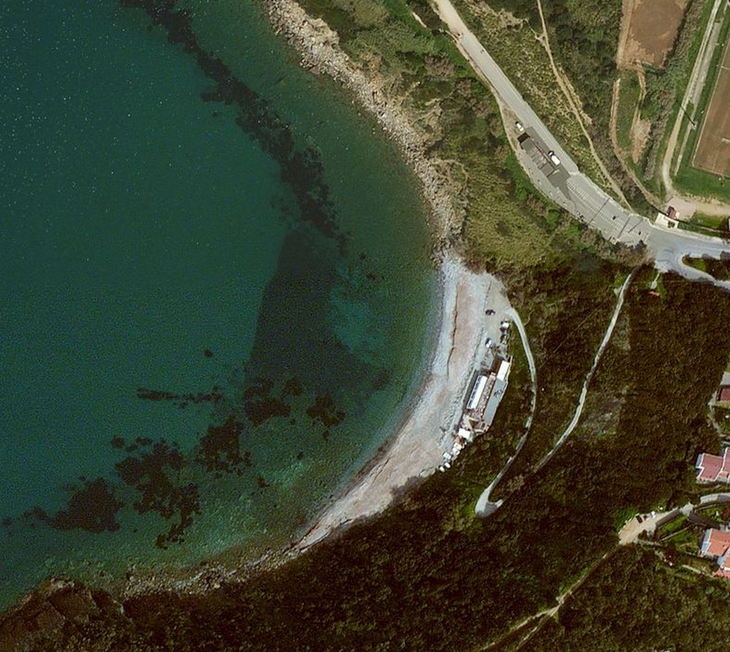
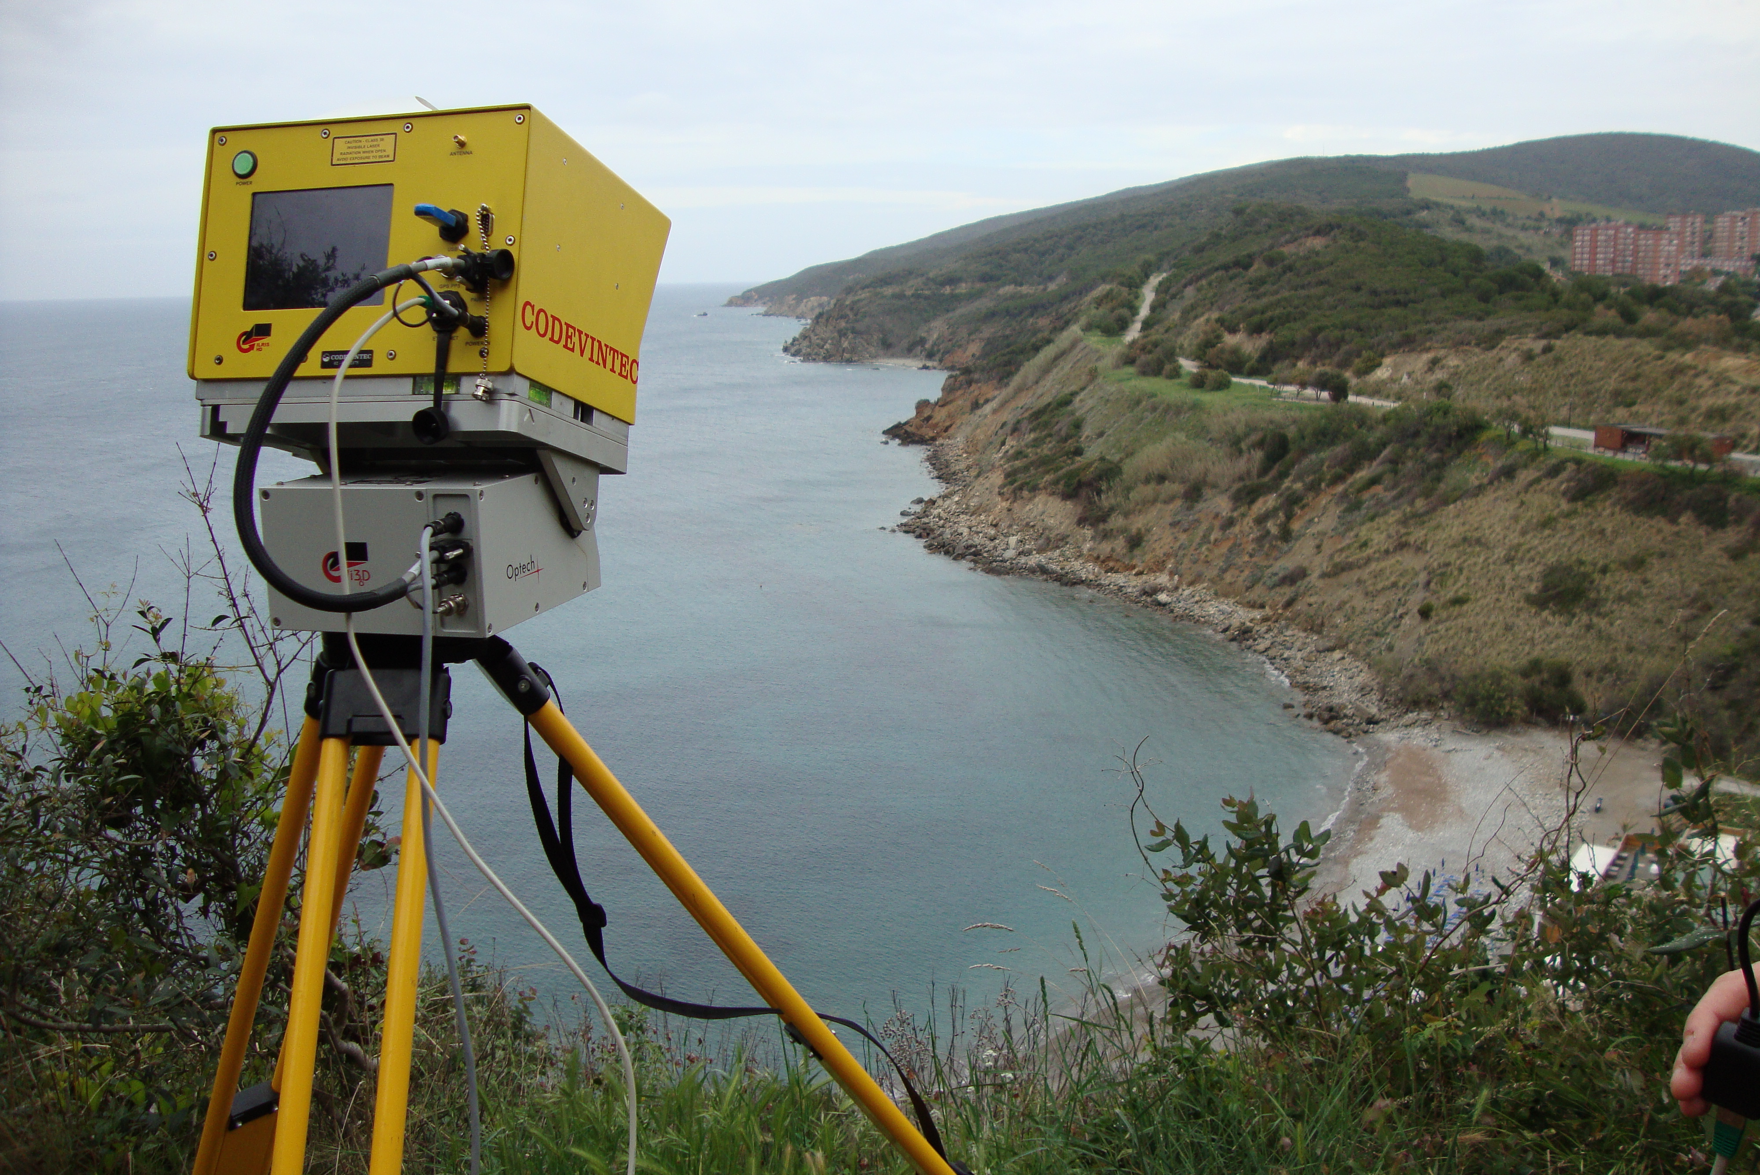
Elevation data sources: Lidar
Direct measurements of the elevation
Airborne laser scanning (ALS)
Terrestrial laser scanning (TLS)
Scan positions
TLS, Optech
Application: Identify the current geomorphic state of a coastal area

Slide 36
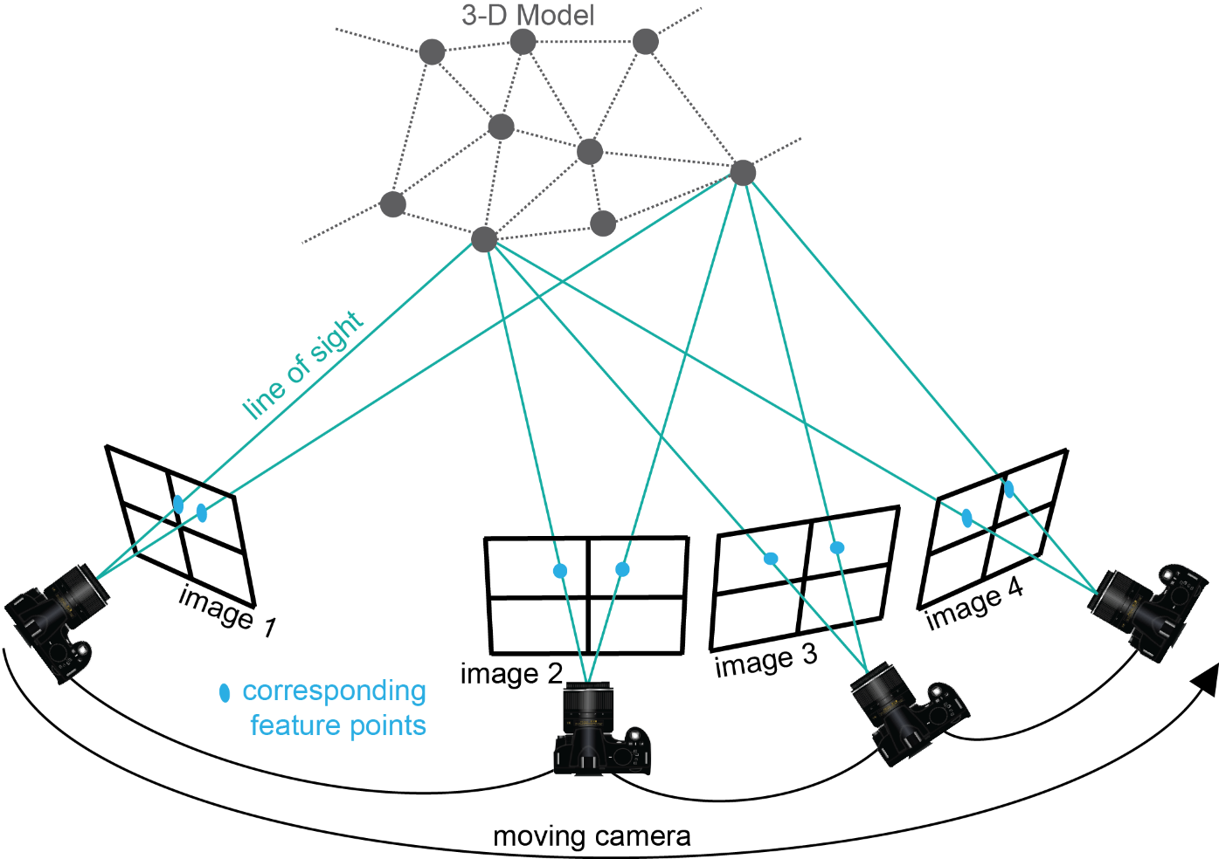
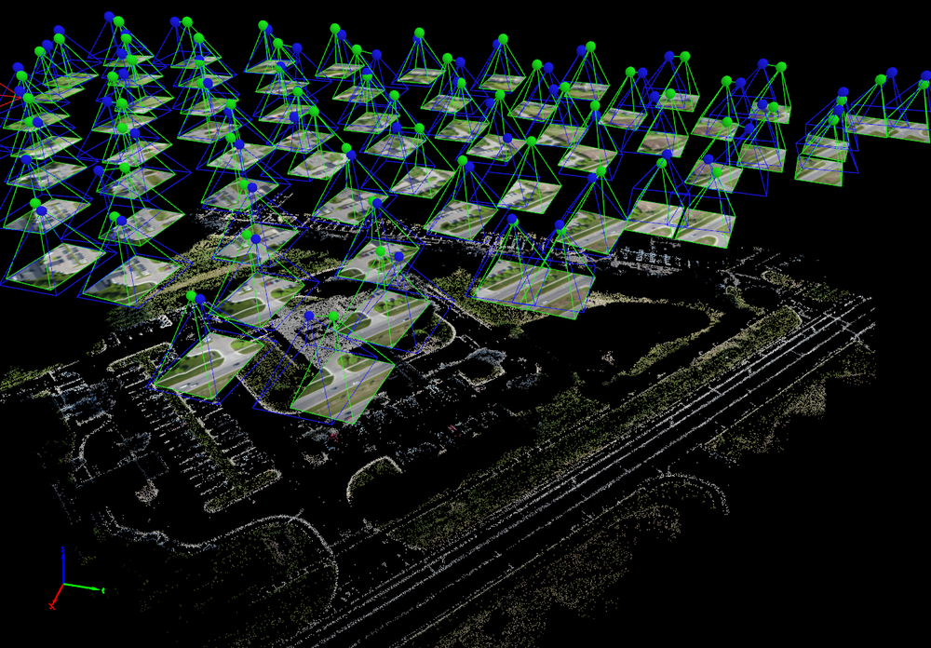
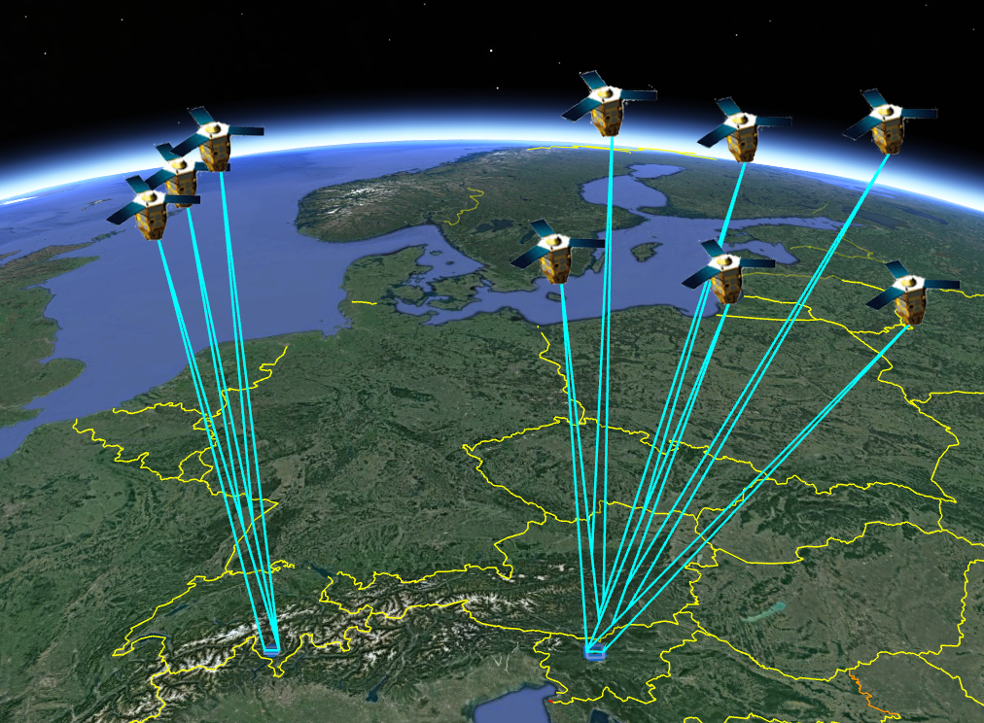
Elevation data sources: Photogrammetry
Digital photogrammetry, terrestrial, aerial and satellite images
Terrestrial Structure from Motion
(ground based)
Aerial, UAV photogrammetry
Flight height ~2000 asl
Stereo (tri-stereo) Satellite
(Pleiades, orbit height ~680 km)

Slide 37
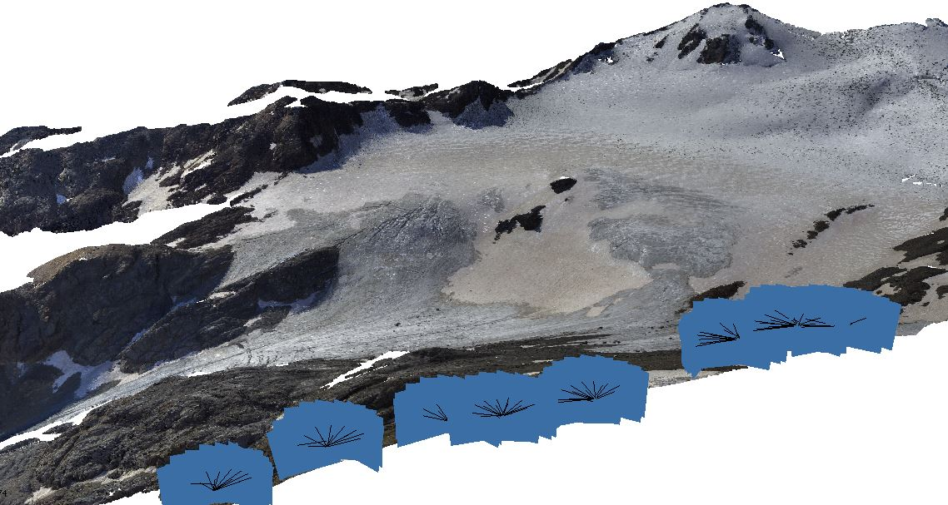
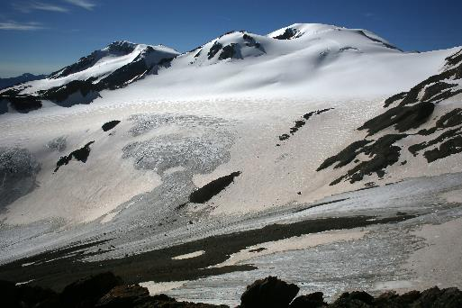

Elevation data sources: Photogrammetry
Digital photogrammetry, terrestrial aerial and satellite images
Terrestrial images (Structure from Motion)
Data format:
3D Point cloud (x,y,z)
.las, .laz
RGB (digital camera)
Black/white colour (frame camera)
Multispectral band, e.g. NIR (depends on the sensors)
3D photogrammetric point cloud of valley glacier (Italian Alps)

Slide 38
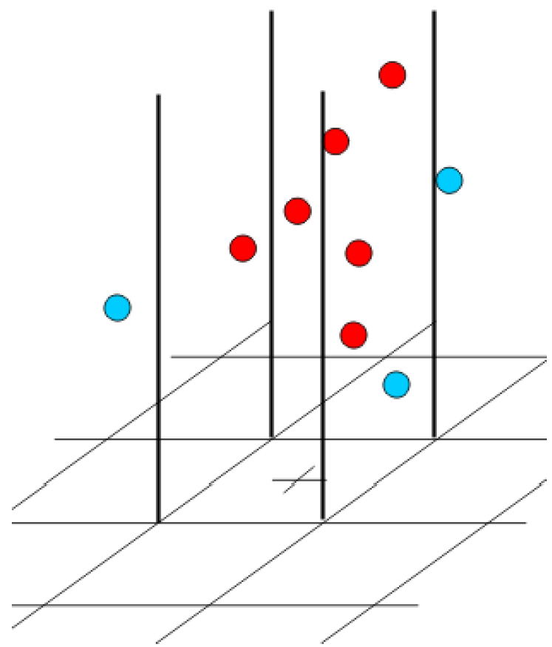
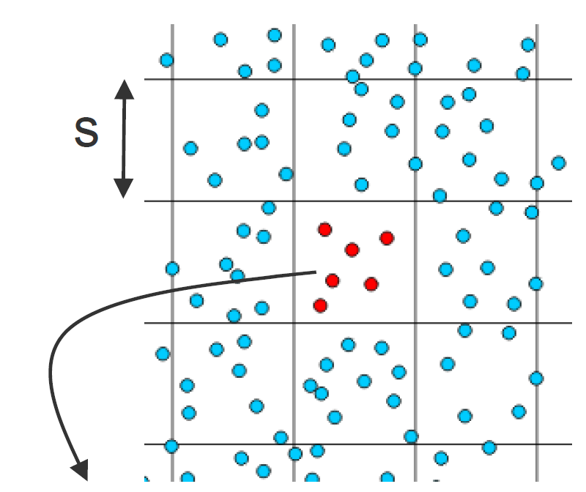
DEM from point cloud
Common information of 3D point cloud
Point density or ground spacing: the distance between points at the ground (usually in point per square meter, pts/m²), at which the 3D points are generated or collected.
The point density defines the details (resolution) of your DEM
Square meter on the ground
z
3D view of elevation points
6 pts/m²

Slide 39
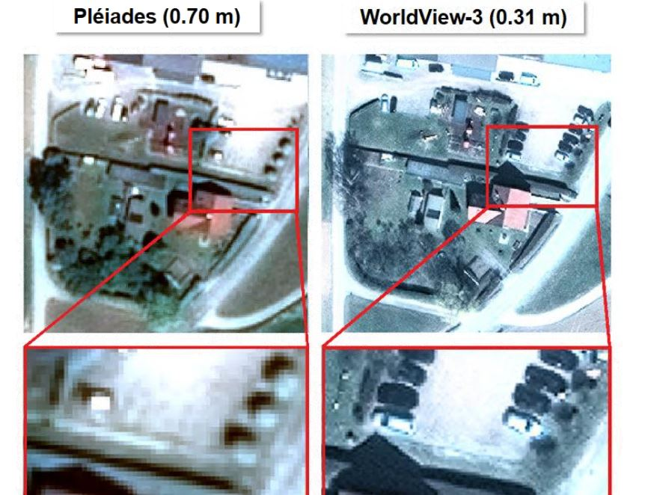
DEM from point cloud
DEM from Image:
The point density is defined by the pixel size (pixel resolution)
The resolution depends on the source image pixel size which depends on sensor and on the distance of the sensor to the object (e.g. flight height in aerial surveying)
Level of detail of two satellite images: Pleiades vs WorldView

Slide 40
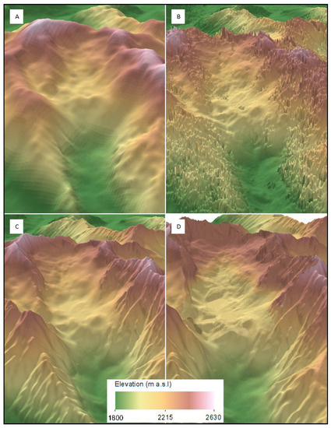
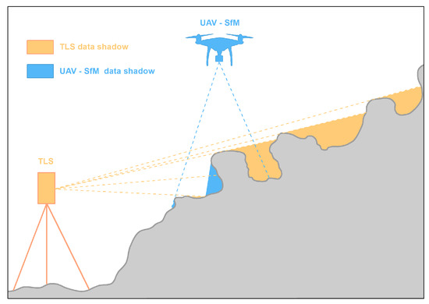
DEM from point cloud
DEM from Lidar and SAR:
The resolution depends on the distance object-sensor and sensor characteristics
Šašak et al., 2019
Level of detail of DEMs derived from (A) the SRTM data, (B) TANDEM-X data, (C) topographic contours (national DEM), and (D) fused TLS and UAV-SfM data.
All DEMs were resampled to 10 m spatial resolution.
Notes:
The Shuttle Radar Topography Mission (SRTM) is an international research effort that obtained digital elevation models on a near-global scale from 56°S to 60°N,[2]: 4820 to generate the most complete high-resolution digital topographic database of Earth prior to the release of the ASTER GDEM in 2009.
TanDEM-X (TerraSAR-X add-on for Digital Elevation Measurement) is the name of TerraSAR-X's twin satellite, a German Earth observation satellite using SAR (Synthetic Aperture Radar) - a modern radar imaging technology.

Slide 41

DEM: What is a LAS file?
LAS file is an industry-standard binary format for storing airborne LiDAR data (in general 3D point cloud)
Quickly display and conduct a statistical analysis of point clouds (ArcMap: LAS Point Statistics As Raster)
Create surface DEM or TIN directly: (ArcMap: LAS Dataset To Raster, LAS Dataset To TIN)
Conduct initial quality check, assessing data coverage and point sample density
Standard classification of the LAS points
Incorporate additional surface features with xyz information: e.g. intensity
High compression: smaller file size
Commonly point cloud (.las) are divided in tiles and you have a LAS dataset
Example of the file size of a 1-square-km tile at 2 pts/m²
LAS File Size: 248,408 KB
ASCII All Points Size: 292,766 KB
Notes:
https://desktop.arcgis.com/en/arcmap/latest/manage-data/las-dataset/what-is-a-las-dataset-.htm

Slide 42

DEM: What is a LAS file?
Point cloud classification (mainly LiDAR points)
Each LIDAR point in a LAS file can have a classification code set for it.
Classifying LIDAR data allows you to organize points into specific data classes
LAS Classification Code
https://desktop.arcgis.com/en/arcmap/latest/manage-data/las-dataset/working-with-las-classifications-in-arcgis.htm
Notes:
‘Point classification is usually completed by data vendors using semi-automated techniques on the point cloud to assign the feature type associated with each point.’

Slide 43

DEM: What is a LAS file?
Point cloud classification (mainly LiDAR points)
Each LIDAR point in a LAS file can have a classification code set for it.
Classifying LIDAR data allows you to organize points into specific data classes

Slide 44



DEM: Work with LAS files
ArcMap tool for LAS file
LAS Dataset To Raster LAS Dataset To TIN
https://desktop.arcgis.com/en/arcmap/latest/tools/3d-analyst-toolbox/las-dataset-to-tin.htm
Notes:
https://desktop.arcgis.com/en/arcmap/latest/manage-data/las-dataset/what-is-a-las-dataset-.htm

Slide 45
DEM: Point cloud interpolation
Interpolates a DTM or a DSM from a point cloud using one of the interpolation methods
NEXT STEP:
from the point cloud you create your grid by interpolating the points
Notes:
The input for the interpolations you mention are points,
The method used to interpolate the output raster dataset from the point cloud
There are a variety of tools already built-in in ArcMap, including las-dataset-to-raster and this The whole las toolset and tools on the scripts site that might help
https://desktop.arcgis.com/en/arcmap/latest/tools/data-management-toolbox/interpolate-from-point-cloud.htm

Slide 46
DEM: Point cloud interpolation
Interpolates a DTM or a DSM from a point cloud using one of the interpolation methods
TRIANGULATION — triangulated irregular network (TIN) linear interpolation designed for irregularly distributed sparse points
NATURAL_NEIGHBOR —This is similar to triangulation but generates a smoother surface and is more computationally intensive.
IDW —This is used for regularly distributed dense points, such as point cloud LAS files from Lidar. The IDW search radius is automatically computed based on average point density.
KRIGING
(The form of the point cloud can be either LAS files or a solution point table)
Lecture 3 & 4
Notes:
The input for the interpolations you mention are points,
The method used to interpolate the output raster dataset from the point cloud
There are a variety of tools already built-in in ArcMap, including las-dataset-to-raster and this The whole las toolset and tools on the scripts site that might help
https://desktop.arcgis.com/en/arcmap/latest/tools/data-management-toolbox/interpolate-from-point-cloud.htm

Slide 47
DEM: Point cloud interpolation
Interpolates a DTM or a DSM from a point cloud using one of the interpolation methods
TRIANGULATION — triangulated irregular network (TIN) linear interpolation designed for irregularly distributed sparse points
NATURAL_NEIGHBOR —This is similar to triangulation but generates a smoother surface and is more computationally intensive.
IDW —This is used for regularly distributed dense points, such as point cloud LAS files from Lidar. The IDW search radius is automatically computed based on average point density.
KRIGING
(The form of the point cloud can be either LAS files or a solution point table)
The choice depends:
Data source (Lidar, photogram.)
Point density (resolution of your point cloud)
Applications
…
There is no best option, Combination and adjustment of these algorithms also exist
Notes:
For DEM interpolation adjustments of these interpolation algorithm exists to adapt the interpolated surfaces better to real terrain conditions.
Local interpolators often result in artificial hills and sinks (IDW), global interpolator do not adapt local structures. Combination!!
it will depend on the resolution of your point cloud (how close your raw data points/dots are).

Slide 48
DEM: Point cloud interpolation
Void filling
Areas of NoData may exist where pixels do not have enough information from the input to generate any values
A fill DEM is a DEM raster where no Data area are filled
The Void fill method is an interpolation:
NONE—NoData is assigned to the cell.
SIMPLE—Averages the values from data cells immediately surrounding a NoData cell to eliminate small voids.
LINEAR—Triangulates across void areas and uses linear interpolation on the triangulated value to determine the cell value.
NATURAL_NEIGHBOR—Uses natural neighbor interpolation to determine the cell value.

Slide 49
DEM: Point cloud interpolation
Topo to grid solution (Topo to raster)
Areas of NoData may exist where pixels do not have enough information from the input to generate any values
Gridding based on contour data, without first making a TIN
Based on a ”minimum curvature interpolation”
Adaption of terrain features by allowing sharp breaks, filling up of sinks and enforcing correct drainage direction
Inclusion of river network data and break lines for interpolation
”Hydrological” and therefore also ”geomorphologic correct” interpolator
https://pro.arcgis.com/en/pro-app/latest/tool-reference/3d-analyst/topo-to-raster.htm
Notes:
Topo to Raster is the best method for developing DEM data from photogrammetric as well as Lidar point data.
Natural Neighbour provides a good alternative to Kriging.
Hydrologically conditioned DEM (Hydro DEM) is a DEM whose flow direction defines expected flow of water over the terrain (DEM). What is important is the resulting flow pattern, not the actual elevation in the DEM.

Slide 50
Learning Objectives
1
2
3
Elevation data
Definition
DEM data structure
Contour line, TIN, raster
Elevation data source:
Remote sensing
Photogrammetry
Las file
DEM generation
DEM visualization
Hillshaded
Example
Today’s topics

Slide 51

DEM visualization
Introduction: Deriving additional descriptors of land shape (i.e., morphometry) from elevation/terrain data.
Terrain descriptor in ArcGIS
Contour
Hillshade
Solar Radiation
Slope
Aspect
Profile curvature
Plan curvature
Viewshed
Cut Fill
Terrain descriptor in ArcGIS

Slide 52





DEM visualization
DEM raster visualization
By default, a DEM (i.e. grid) is displayed as a grayscale image.
The grayscale value is stretched between the high and low elevation values.
Stretched value between 0 and 255
(visualization)
Example: front moraine
Elevation value

Slide 53




DEM visualization
Contour line visualization
Contour is a tool for visualizing the spatial distribution of elevations in the DEM
Example: front moraine

Slide 54


DEM visualization
Contour line visualization
Smooth contour lines
Contour lines from a raw DEM
NOTE: In order to create smooth contour lines, you first need to smooth the DEM
(in ArcGIS >Focal Statistics tool)

Slide 55




DEM visualization
Contour line visualization
Smooth contour lines
1. Smooth the raster
2. Generate the contour line of the smoothed raster

Slide 56
DEM visualization
Lines: contour lines (or contour) and contour map
Smooth contour lines
NOTE: A rule of the scale at which contour lines are generated: the spacing between the contour lines should be at least twice the pixel size of the DEM (Hengl et al.,2003).

Slide 57

DEM visualization
Shaded relief or hillshade
A hillshade is a grayscale 3D representation of the surface, with the sun's relative position taken into account for shading the image. This function uses the altitude and azimuth (sun direction 0-360 deg) properties to specify the sun's position.
The inputs for this function are the DEM, and sun altitude and azimuth.
Sun altitude ～ time of year, 0°-90°
Solar azimuth ～ time of day (0°-360°)
Hillshading computes surface illumination as values from 0 to 255
Cells facing the sun are most illuminated (value close to 255) while cells facing away from the sun are in shadow
Azimuth is the sun's relative position along the horizon (in degrees). This position is indicated by the angle of the sun measured clockwise from the north. An azimuth of 0 degrees indicates north, east is 90 degrees, south is 180 degrees, and west is 270 degrees
Notes:
Hillshading computes surface illumination as values from 0 to 255 based on a given compass direction to the sun (azimuth) and a certain altitude above the horizon (altitude).

Slide 58



DEM visualization
Shaded relief or hillshade
A hillshade is a grayscale 3D representation of the surface, with the sun's relative position taken into account for shading the image.
It can be generated using the Hillshade tool in ArcGIS
AZIMUTH
ALTITUDE
The ESRI default hillshade has an azimuth of 315 and an altitude of 45 degrees.
Notes:
DISCUSS: How will the “shadows” change with the sun altitude and azimuth?
Hillshading is a shaded relief . It can be modelled as. degree of illumination from an imaginary sun.
Shaded relief or hillshade to enhance the interpretability of the elevation raster: shaded relief is a visually pleasing representation of the terrain assuming an illumination of the raster surface at a defined direction and angle of the light source.

Slide 59




DEM visualization
Hillshade visualization
What is this line here?
Example: front moraine

Slide 60

DEM visualization
Because this drone was never meant for surveying and creates poor data.
UAV, Phantom ProDJI
Hillshade visualization
Hillshade is a very useful tool to detect error, noise and artefact in your elevation row data (point cloud) and therefore in the DEM
The elevation data was collected with an UAV in two different days. This line is an offset in the point cloud generated from the UAV
Example: front moraine

Slide 61

DEM visualization
Hillshade visualization
Bernhardson 2018

Slide 62



DEM visualization
Example: bilobate active rock glacier
Contour lines for visualizing the spatial distribution of elevations in the DEM
Hillshade DEM for visualizing the topography
DEM (grid) for analysis
Notes:
Hillshading is a shaded relief . It can be modelled as. degree of illumination from an imaginary sun.
Shaded relief or hillshade to enhance the interpretability of the elevation raster: shaded relief is a visually pleasing representation of the terrain assuming an illumination of the raster surface at a defined direction and angle of the light source.
Hillshading creates a hypothetical illumination of a surface by setting a position for a light source and calculating an illumination value for each cell based on the cell's relative orientation to the light, or based on the slope and aspect of the cell.

Slide 63


DEM visualization
Shaded relief or hillshade
Traditional hillshade:
hillshade illuminated from 315 deg azimuth - so only single source of light
Multidirectional Hillshade:
a combination of hillshades illuminated from 225, 270, 315, and 360 deg azimuth - 4 different sources of light
https://opengislab.com/
Notes:
Hillshading is a shaded relief . It can be modelled as degree of illumination from an imaginary sun.
Shaded relief or hillshade to enhance the interpretability of the elevation raster: shaded relief is a visually pleasing representation of the terrain assuming an illumination of the raster surface at a defined direction and angle of the light source.
https://opengislab.com/blog/2018/3/20/3d-dem-visualization-in-qgis-30

Slide 64

DEM visualization
Shaded relief or hillshade
Multidirectional hillshade draped over the coloured DEM
Hillshade is not very useful from an analytical point, but a great visualization tool
Often you display the hillshade in semi-transparent overlaid to a DEM. The colour is given by the DEM (stretched values of the elevation from the min to the max) and the hillshade highlight the topography.
https://opengislab.com/
Notes:
DISCUSS: Why aren’t hillshades that useful from an analytical point of view?

Slide 65
DEM visualization
Shaded relief or hillshade
Why the hillshade is not super useful?
Multidirectional hillshade draped over the coloured DEM
Hillshade is not very useful from an analytical point, but a great visualization tool
Because it doesn’t provide any true measure of solar radiation
Just an 8-bit value (0-255) representing relative illumination
https://opengislab.com/

Slide 66

DEM visualization
Shaded relief or hillshade
Multidirectional hillshade draped over the coloured DEM
3D Map View to view/simulate 3D landscape (DEM)
https://opengislab.com/

Slide 67

DEM visualization
Draping of an aerial map on DEM
3D visualization of an aerial (ESRI Aerial base map) draped into the multidirectional hillshade.
https://opengislab.com/

Slide 68

DEM visualization
Shaded relief
Bernhardson 2018

Slide 69

DEM visualization
Slope raster
Bernhardson 2018

Slide 70

DEM visualization
Aspect
Bernhardson 2018

Slide 71

Thanks!
Feedback questions

